Slide 1
THE LIFE OF CHRIST
PART 33

Slide 2
Matthew 8:5 Now when Jesus had entered Capernaum, a centurion came to Him, pleading with Him, ⁶ saying, "Lord, my servant is lying at home paralyzed, dreadfully tormented." ⁷ And Jesus said to him, "I will come and heal him." ⁸ The centurion answered and said, "Lord, I am not worthy that You should come under my roof. But only speak a word, and my servant will be healed. ⁹ "For I also am a man under authority, having soldiers under me. And I say to this one, 'Go,' and he goes; and to another, 'Come,' and he comes; and to my servant, 'Do this,' and he does it."

Slide 3
¹⁰ When Jesus heard it, He marveled, and said to those who followed, "Assuredly, I say to you, I have not found such great faith, not even in Israel! ¹¹ "And I say to you that many will come from east and west, and sit down with Abraham, Isaac, and Jacob in the kingdom of heaven. ¹² "But the sons of the kingdom will be cast out into outer darkness. There will be weeping and gnashing of teeth." ¹³ Then Jesus said to the centurion, "Go your way; and as you have believed, so let it be done for you." And his servant was healed that same hour.

Slide 4
Luke 7:1 Now when He concluded all His sayings in the hearing of the people, He entered Capernaum. ² And a certain centurion's servant, who was dear to him, was sick and ready to die. ³ So when he heard about Jesus, he sent elders of the Jews to Him, pleading with Him to come and heal his servant. ⁴ And when they came to Jesus, they begged Him earnestly, saying that the one for whom He should do this was deserving, ⁵ "for he loves our nation, and has built us a synagogue." ⁶ Then Jesus went with them. And when He was already not far from the house, the centurion sent friends to Him, saying to Him, "Lord, do not trouble Yourself, for I am not worthy that You should enter under my roof.

Slide 5
⁷ "Therefore I did not even think myself worthy to come to You. But say the word, and my servant will be healed. ⁸ "For I also am a man placed under authority, having soldiers under me. And I say to one, 'Go,' and he goes; and to another, 'Come,' and he comes; and to my servant, 'Do this,' and he does it." ⁹ When Jesus heard these things, He marveled at him, and turned around and said to the crowd that followed Him, "I say to you, I have not found such great faith, not even in Israel!" ¹⁰ And those who were sent, returning to the house, found the servant well who had been sick.

Slide 6
If you were paying attention, Matthew’s account says this: a centurion came to Him, pleading with Him, and Luke’s account says this:
So when he heard about Jesus, he sent elders of the Jews to Him, pleading with Him to come and heal his servant.

Slide 7
John 3:22 After these things Jesus and His disciples came into the land of Judea, and there He remained with them and baptized.
John 3:26 And they came to John and said to him, "Rabbi, He who was with you beyond the Jordan, to whom you have testified -- behold, He is baptizing, and all are coming to Him!"

Slide 8
John 4:1 Therefore, when the Lord knew that the Pharisees had heard that Jesus made and baptized more disciples than John ² (though Jesus Himself did not baptize, but His disciples), ³ He left Judea and departed again to Galilee.

Slide 9
Matthew 8:7 And Jesus said to him, "I will come and heal him."

Slide 10
And when He was already not far from the house, the centurion sent friends to Him, saying to Him, "Lord, do not trouble Yourself, for I am not worthy that You should enter under my roof. ⁷ "Therefore I did not even think myself worthy to come to You. But say the word, and my servant will be healed. ⁸ "For I also am a man placed under authority, having soldiers under me. And I say to one, 'Go,' and he goes; and to another, 'Come,' and he comes; and to my servant, 'Do this,' and he does it."

Slide 11
⁹ When Jesus heard these things, He marveled at him, and turned around and said to the crowd that followed Him, "I say to you, I have not found such great faith, not even in Israel!" ¹⁰ And those who were sent, returning to the house, found the servant well who had been sick.

Slide 12
John 20:29 … "Thomas, because you have seen Me, you have believed. Blessed are those who have not seen and yet have believed."

Slide 13
Matthew 8:11 "And I say to you that many will come from east and west, and sit down with Abraham, Isaac, and Jacob in the kingdom of heaven. ¹² "But the sons of the kingdom will be cast out into outer darkness. There will be weeping and gnashing of teeth."

Slide 14
Philippians 2:3 Let nothing be done through selfish ambition or conceit, but in lowliness of mind let each esteem others better than himself. ⁴ Let each of you look out not only for his own interests, but also for the interests of others. ⁵ Let this mind be in you which was also in Christ Jesus,

Slide 15
Romans 12:3 For I say, through the grace given to me, to everyone who is among you, not to think of himself more highly than he ought to think, but to think soberly, as God has dealt to each one a measure of faith.

Slide 16
1 Peter 5:5 Likewise you younger people, submit yourselves to your elders. Yes, all of you be submissive to one another, and be clothed with humility, for "God resists the proud, But gives grace to the humble."

Slide 17
Luke 7:11 Now it happened, the day after, that He went into a city called Nain; and many of His disciples went with Him, and a large crowd.

Slide 18
There are many ancient remains of Nain, proving that the place was once of considerable size." It is located "on the northwestern edge of `Little Hermon,' where the ground falls into the plain of Esdraelon." Just east of the city are the remains of rock sepulchres; and the extensive ruins disprove the notion that the place was merely "a humble village of mud-built houses near Nazareth." Luke was altogether correct in calling the place a "city." Today the village is a rather insignificant place called Nein.

Slide 19
Luke 7:12 And when He came near the gate of the city, behold, a dead man was being carried out, the only son of his mother; and she was a widow. And a large crowd from the city was with her.

Slide 20
As the funeral procession passed, everyone was expected, if possible, to join the convoy. The Rabbis applied to the observance of this direction the following verses:
Proverbs 14:32 The wicked is banished in his wickedness, But the righteous has a refuge in his death.
Proverbs 19:17 He who has pity on the poor lends to the LORD, And He will pay back what he has given.

Slide 21
And to its neglect:
Proverbs 17:5 He who mocks the poor reproaches his Maker; He who is glad at calamity will not go unpunished.
Burial followed generally as soon as possible after death (Matt. 9:23; Acts 5:6, 10; 8:2), no doubt partly on sanitary grounds. For special reasons, however (Acts 9:37,39), or in the case of parents, there might be a delay of even days (page 154.)

Slide 22
From the account of the funeral procession at Nain … many interesting details can be learned. First, burying places were always outside of cities (Matt. 8:28; 27:7, 52, 53; Jon 11:30,31). Neither watercourses nor public roads were allowed to pass through them, nor sheep to graze there…It was the practice to visit the graves (John 11:31) partly to mourn and partly to pray. It was unlawful to eat or drink, to read, or even to walk irreverently among them.

Slide 23
Secondly, we know that, as at Nain, the body was generally carried open on a bier, or else in an open coffin, the bearers frequently changing to give an opportunity to many to take part in a work deemed so meritorious.
Lastly, the order in which the procession seems to have wound out of Nain exactly accords with what we know of the custom of the time and place. It was outside the city gate that the Lord with His disciples met the sad array (Sketches of Jewish Social life p. 155- 156).

Slide 24
Luke 7:13 When the Lord saw her, He had compassion on her and said to her, "Do not weep." ¹⁴ Then He came and touched the open coffin, and those who carried him stood still. And He said, "Young man, I say to you, arise." ¹⁵ So he who was dead sat up and began to speak. And He presented him to his mother.

Slide 25
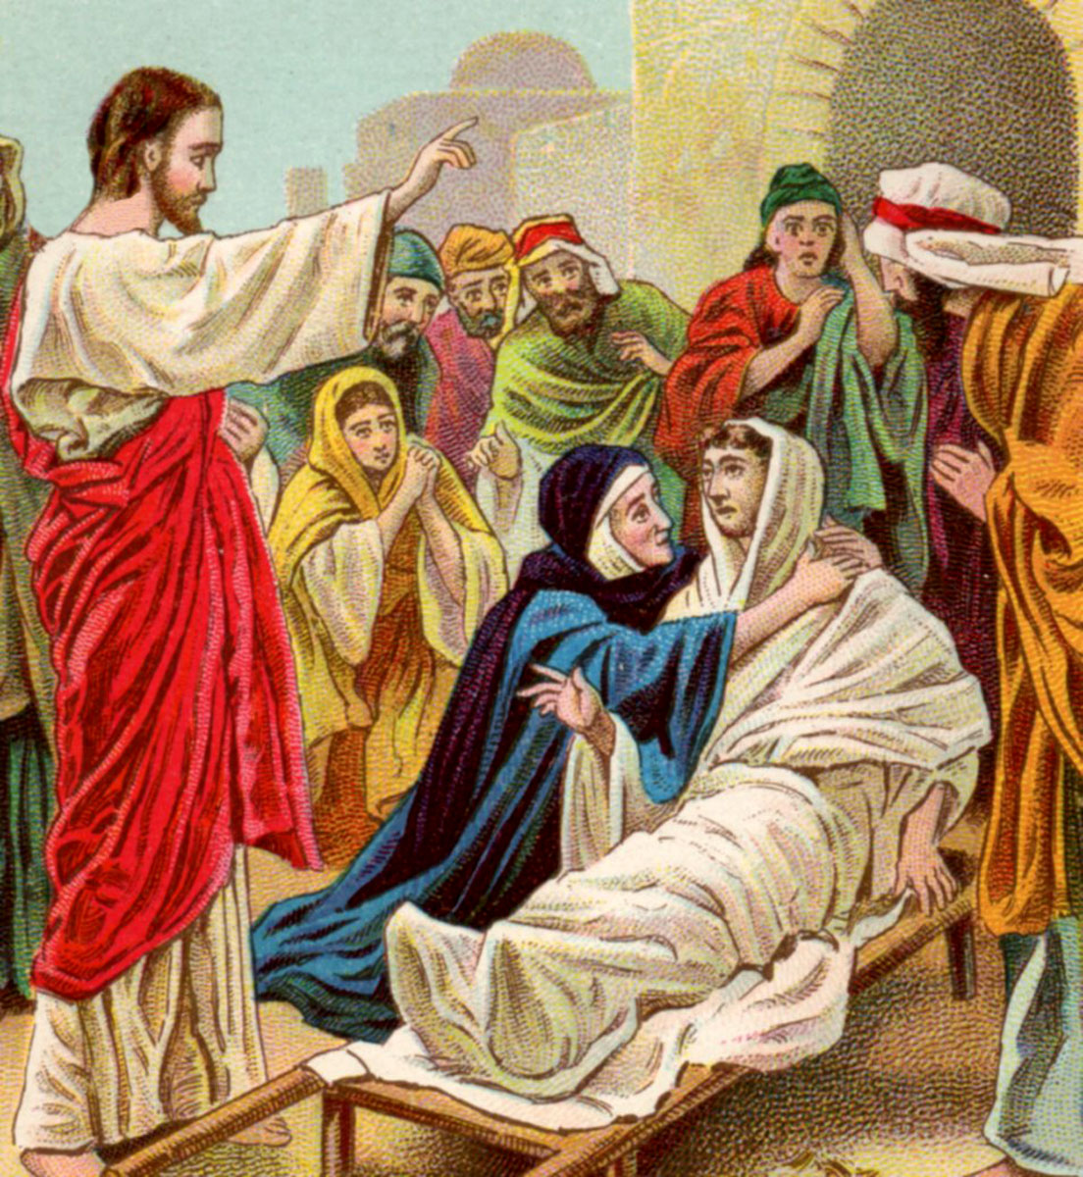

Slide 26
Luke 7:16 Then fear came upon all, and they glorified God, saying, "A great prophet has risen up among us"; and, "God has visited His people." ¹⁷ And this report about Him went throughout all Judea and all the surrounding region.

Slide 27
Luke 7:18 Then the disciples of John reported to him concerning all these things. ¹⁹ And John, calling two of his disciples to him, sent them to Jesus, saying, "Are You the Coming One, or do we look for another?" ²⁰ When the men had come to Him, they said, "John the Baptist has sent us to You, saying, 'Are You the Coming One, or do we look for another?' " ²¹ And that very hour He cured many of infirmities, afflictions, and evil spirits; and to many blind He gave sight. ²² Jesus answered and said to them, "Go and tell John the things you have seen and heard: that the blind see, the lame walk, the lepers are cleansed, the deaf hear, the dead are raised, the poor have the gospel preached to them. ²³ "And blessed is he who is not offended because of Me."

Slide 28
Matthew 10:32 " Therefore whoever confesses Me before men, him I will also confess before My Father who is in heaven. ³³ "But whoever denies Me before men, him I will also deny before My Father who is in heaven.

